Slide 1

Employee Retention
By: Dane Holmes

Slide 2
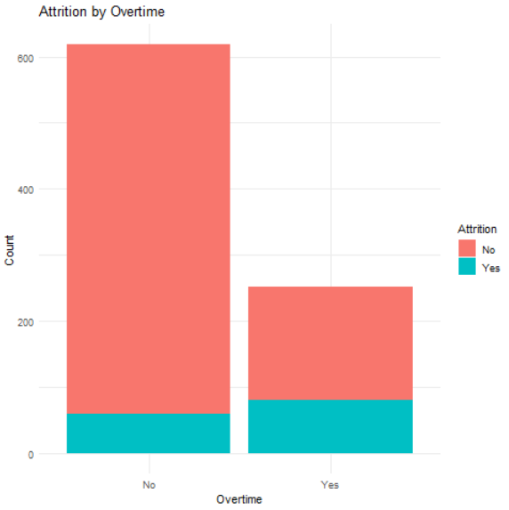
Top 3 Attrition Factors Average = 16%
Overtime
p-value = 1.74E-16
Average = 32%
Overtime | Stayed | Left | Attrition Rate
Yes | 172 | 80 | 32%
No | 558 | 60 | 10%
Employees who work overtime are three times more likely to leave than those who don’t.

Slide 3
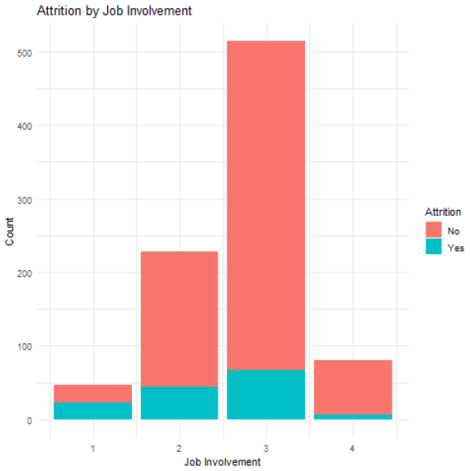
Top 3 Attrition Factors Average = 16%
2. Job Involvement
p-value = 5.17E-08
Job Involvement | Stayed | Left | Attrition Rate
1 | 25 | 22 | 47%
2 | 184 | 44 | 19%
3 | 447 | 67 | 13%
4 | 74 | 7 | 9%
Nearly half of all employees with a Job Involvement of 1 left. Only one point higher brought the attrition rate to within 3 points of the average

Slide 4
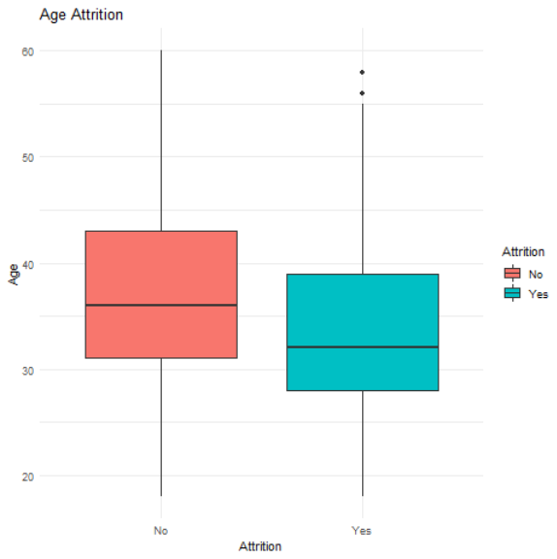
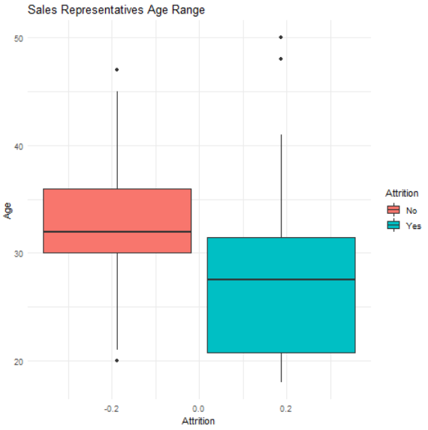
Top 3 Attrition Factors Average = 16%
3. Age
p-value = 5.98E-06
Age Group | Stayed | Left | Attrition Rate
<25 | 35 | 20 | 36%
25-29 | 98 | 32 | 25%
30-34 | 171 | 35 | 17%
>50 | 76 | 13 | 15%
35-39 | 156 | 19 | 11%
40-44 | 109 | 12 | 10%
45-49 | 85 | 9 | 10%
Younger employees leave at a higher rate than older employees. Even in job roles with very high turnover like Sales Representatives, those who leave are heavily right skewed.

Slide 5
Linear Regression Logistical Regression Naïve Bayes Random Forest
Attrition Models
 | Accuracy | Sensitivity | Specificity
Linear Regression | 81-90% | 99% | 20%
Logistical Regression | 80-88% | 89% | 61%
Naïve Bayes | 78-89% | 93% | 37%
Random Forest | 70-77% | 76% | 72%

Slide 6
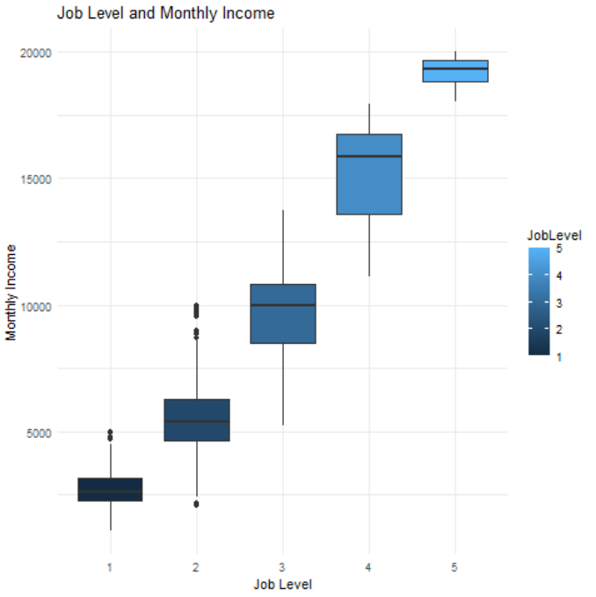
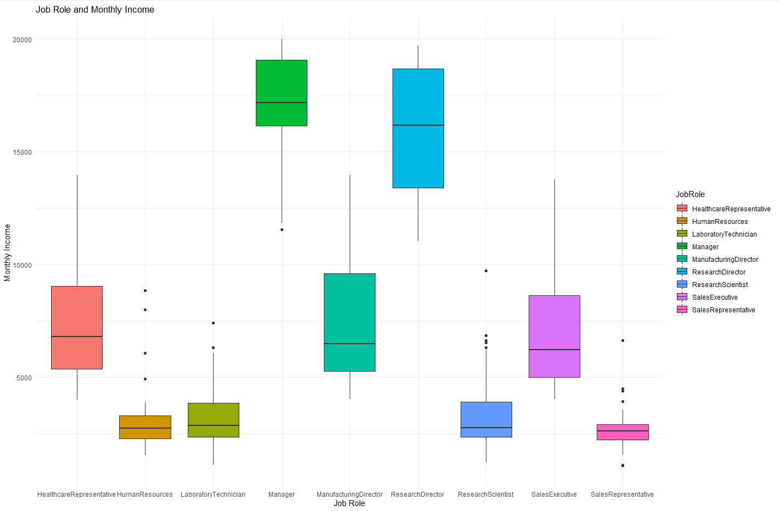
Monthly Income Top Factors
Job Level with a correlation of 95% and Job Role

Slide 7
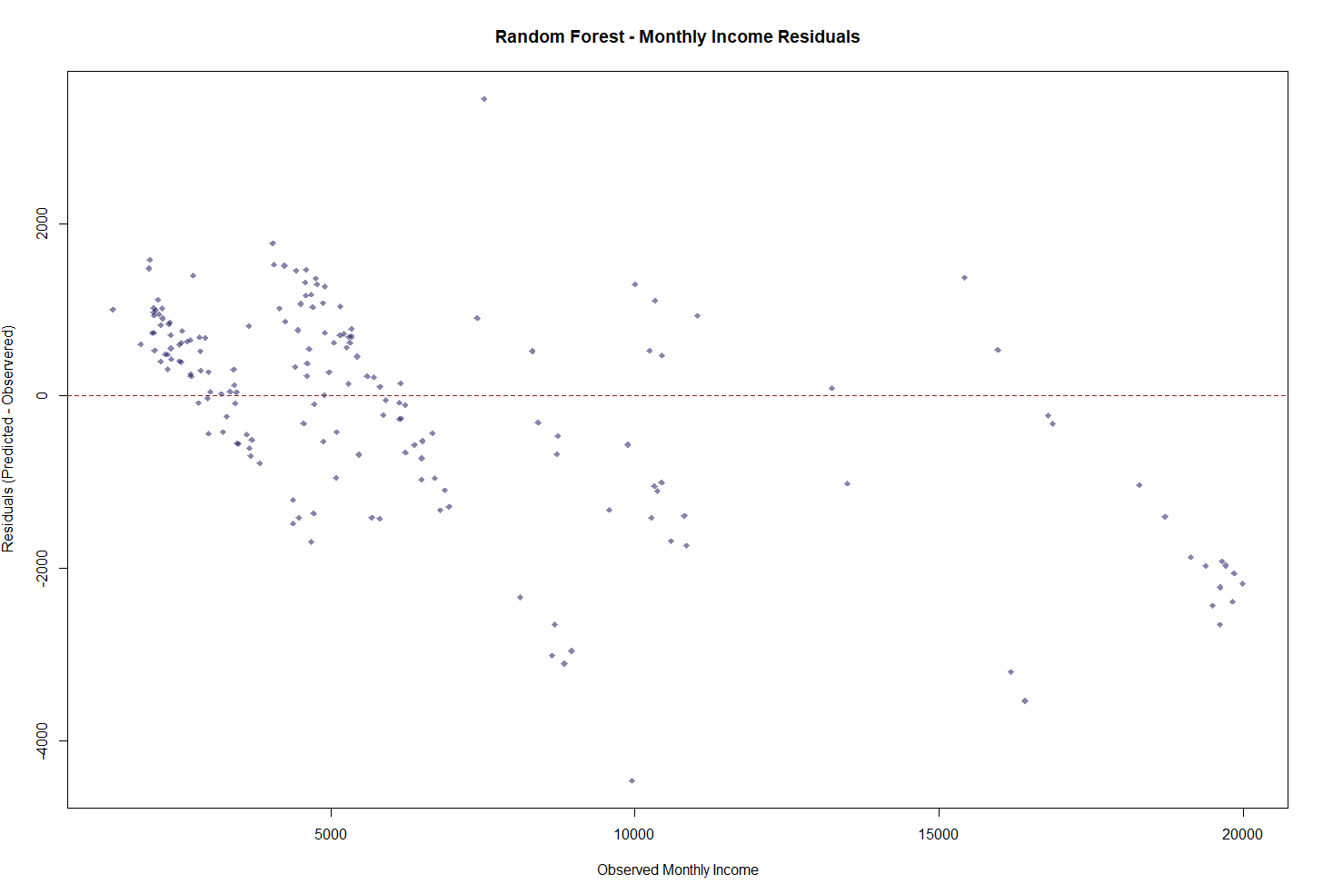
Linear Regression RMSE = $1090.97
Monthly Income

Slide 8
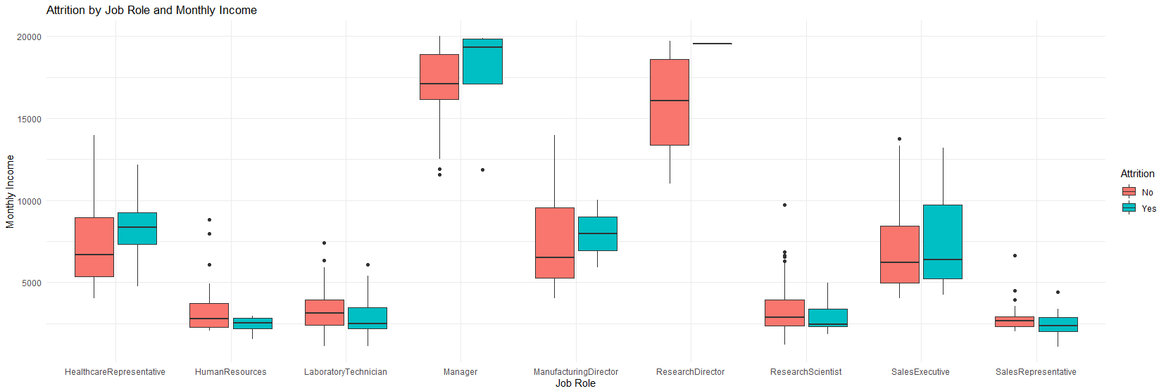
Trends Job Roles
Those who left in high paying fields like Manager, Healthcare Reps, Manufacturing Directors, and Sales Execs made more. While in lower paying fields the opposite is true.

Slide 9
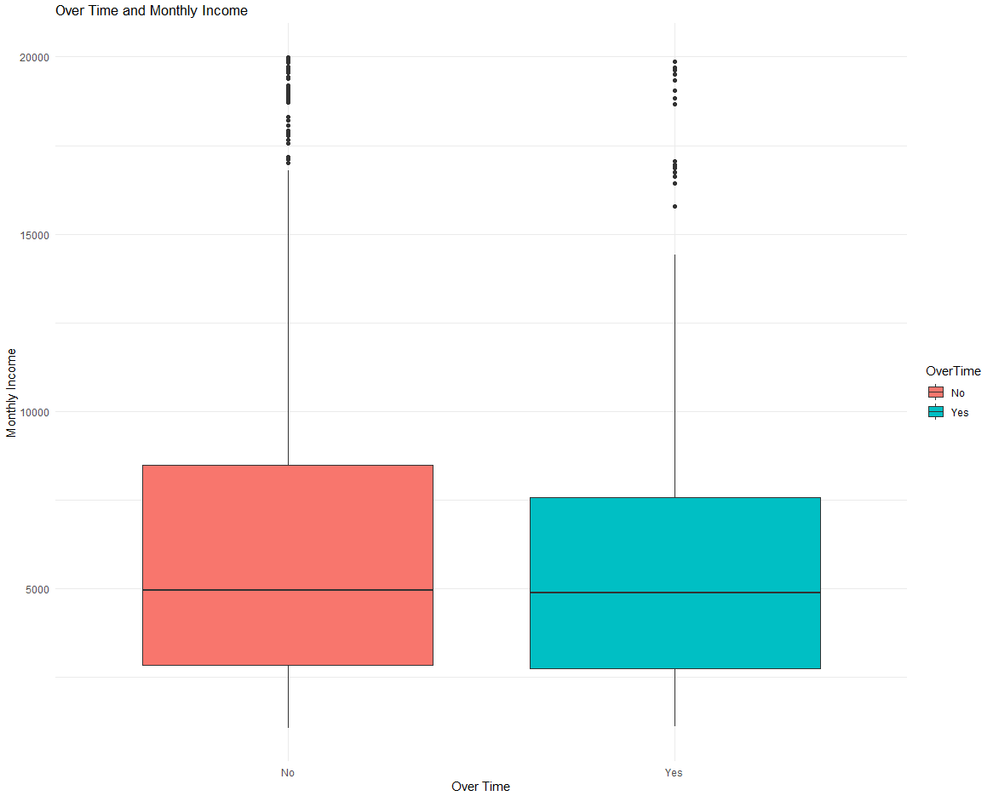
Trends Overtime Pay
Working overtime is the number one reason for attrition while also resulting in no increase in Monthly Income.
Overtime has no correlation to Monthly Income

Slide 10
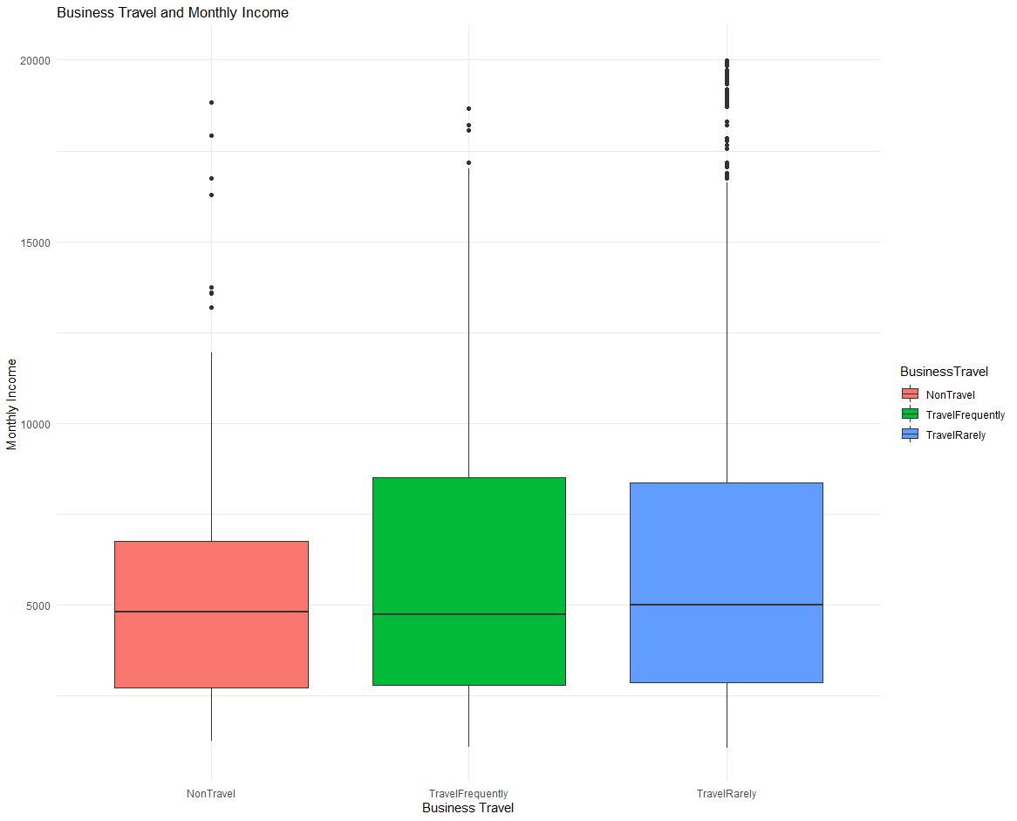
Trends Travel Pay
Positions with some travel result in a higher Q3 of monthly income.
However, there is no noticeable increase from traveling frequently vs. rarely.

Slide 11
Conclusion
While there are factors outside of the control of the employer (Age, Marital Status, Job Role, etc.), two of the highest causes are completely within employer control (Overtime and Employee Involvement).
Employers should focus their efforts in reducing overtime and increasing employee involvement.

